Slide 1



HuskyBytes
Amey Bansod - 002743117
Harshil Shah - 002780887
Keerthana Satheesh - 002747795
Saloni Talwar – 002924067
@connectamey
@harshilshh
@keerthana-satheesh
@saloni-talwar-03
Notes:
https://northeastern.instructure.com/courses/123854/assignments/1471922

Slide 2

What Is IELSTAR?
IELTSTAR is an online IELTS test platform
The platform provides multiple mock tests to help users improve their listening, reading, writing, and speaking IELTS exam performance
It can predict the user's overall IELTS band score with a score calculator
It lets users send scores via SMS and Email
It have an interactive dashboard for registered users to help track their progress and view past test mock exams.

Slide 3











TECH STACK

Slide 4







EXTERNAL APIs & Libraries
Auth0
Twilio SMS
Twilio SendGrid
Grammarly
React Speech Recognition
OneSignal
Cloudinary
ApexCharts

Slide 5
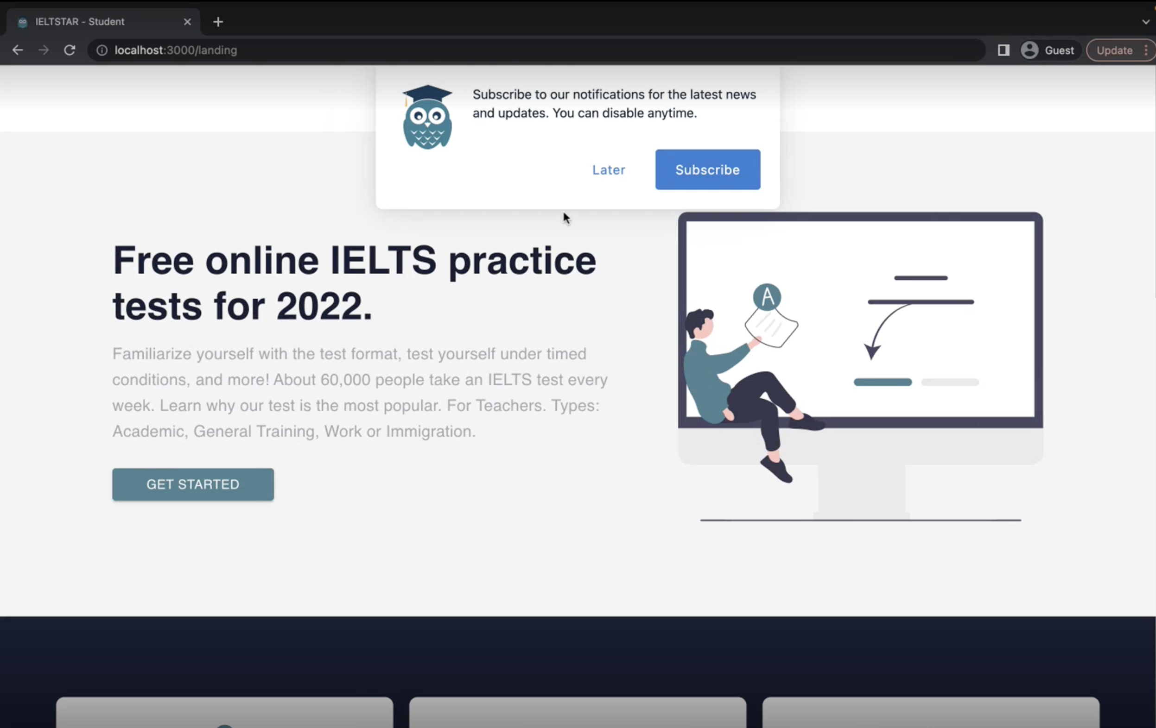
LANDING PAGE

Slide 6
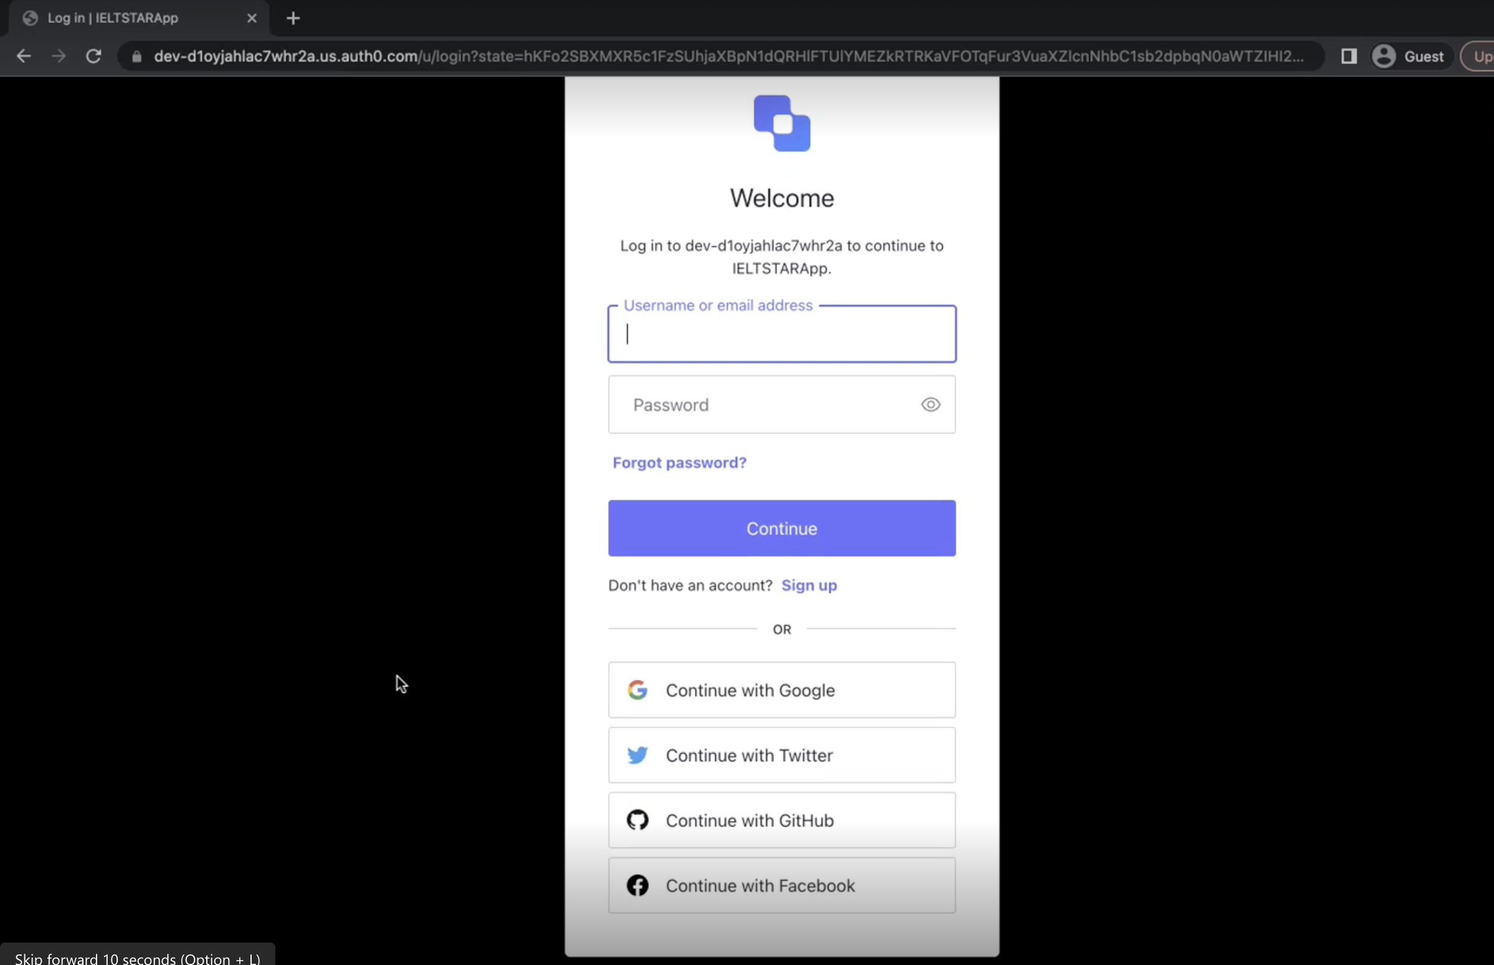
LOGIN (AUTH0)

Slide 7
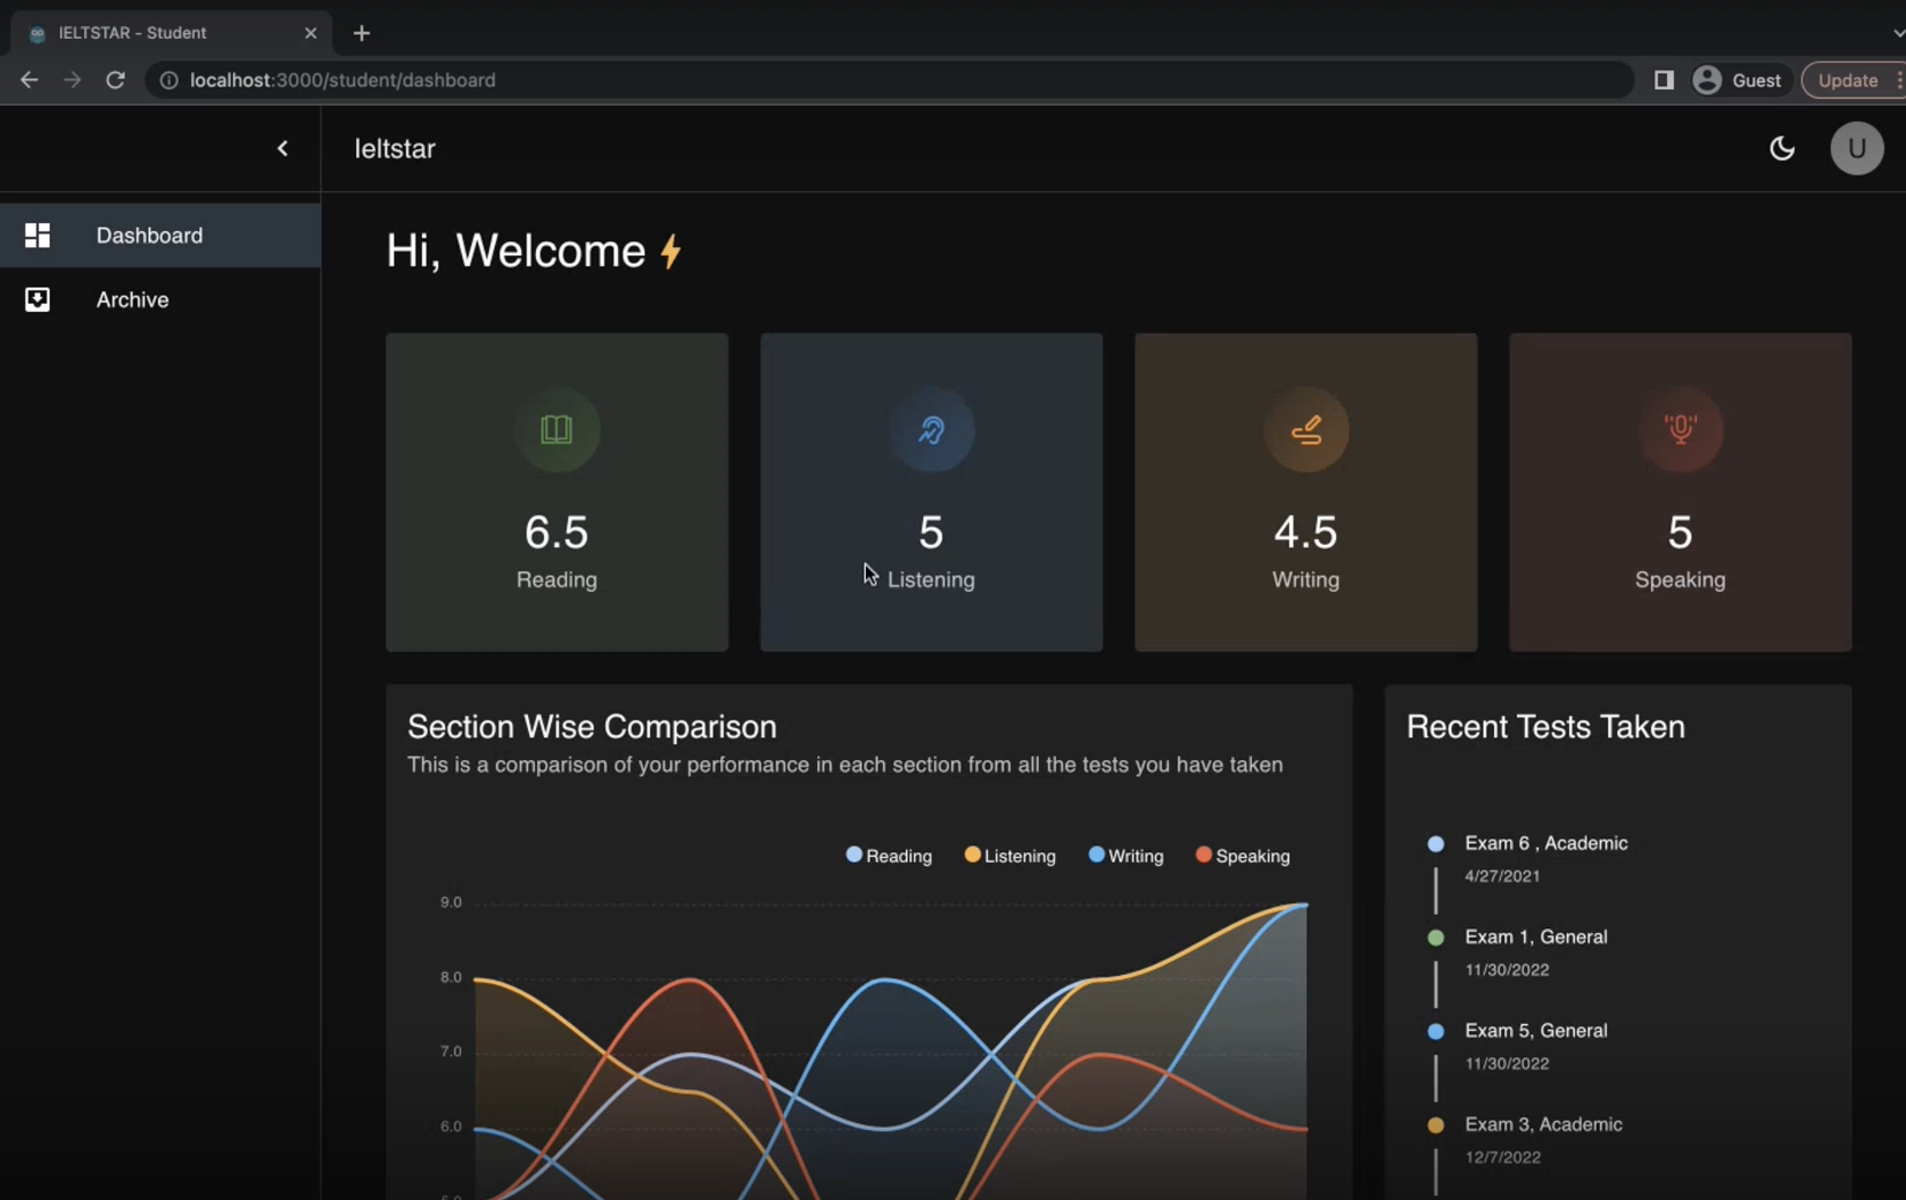
DASHBOARD

Slide 8
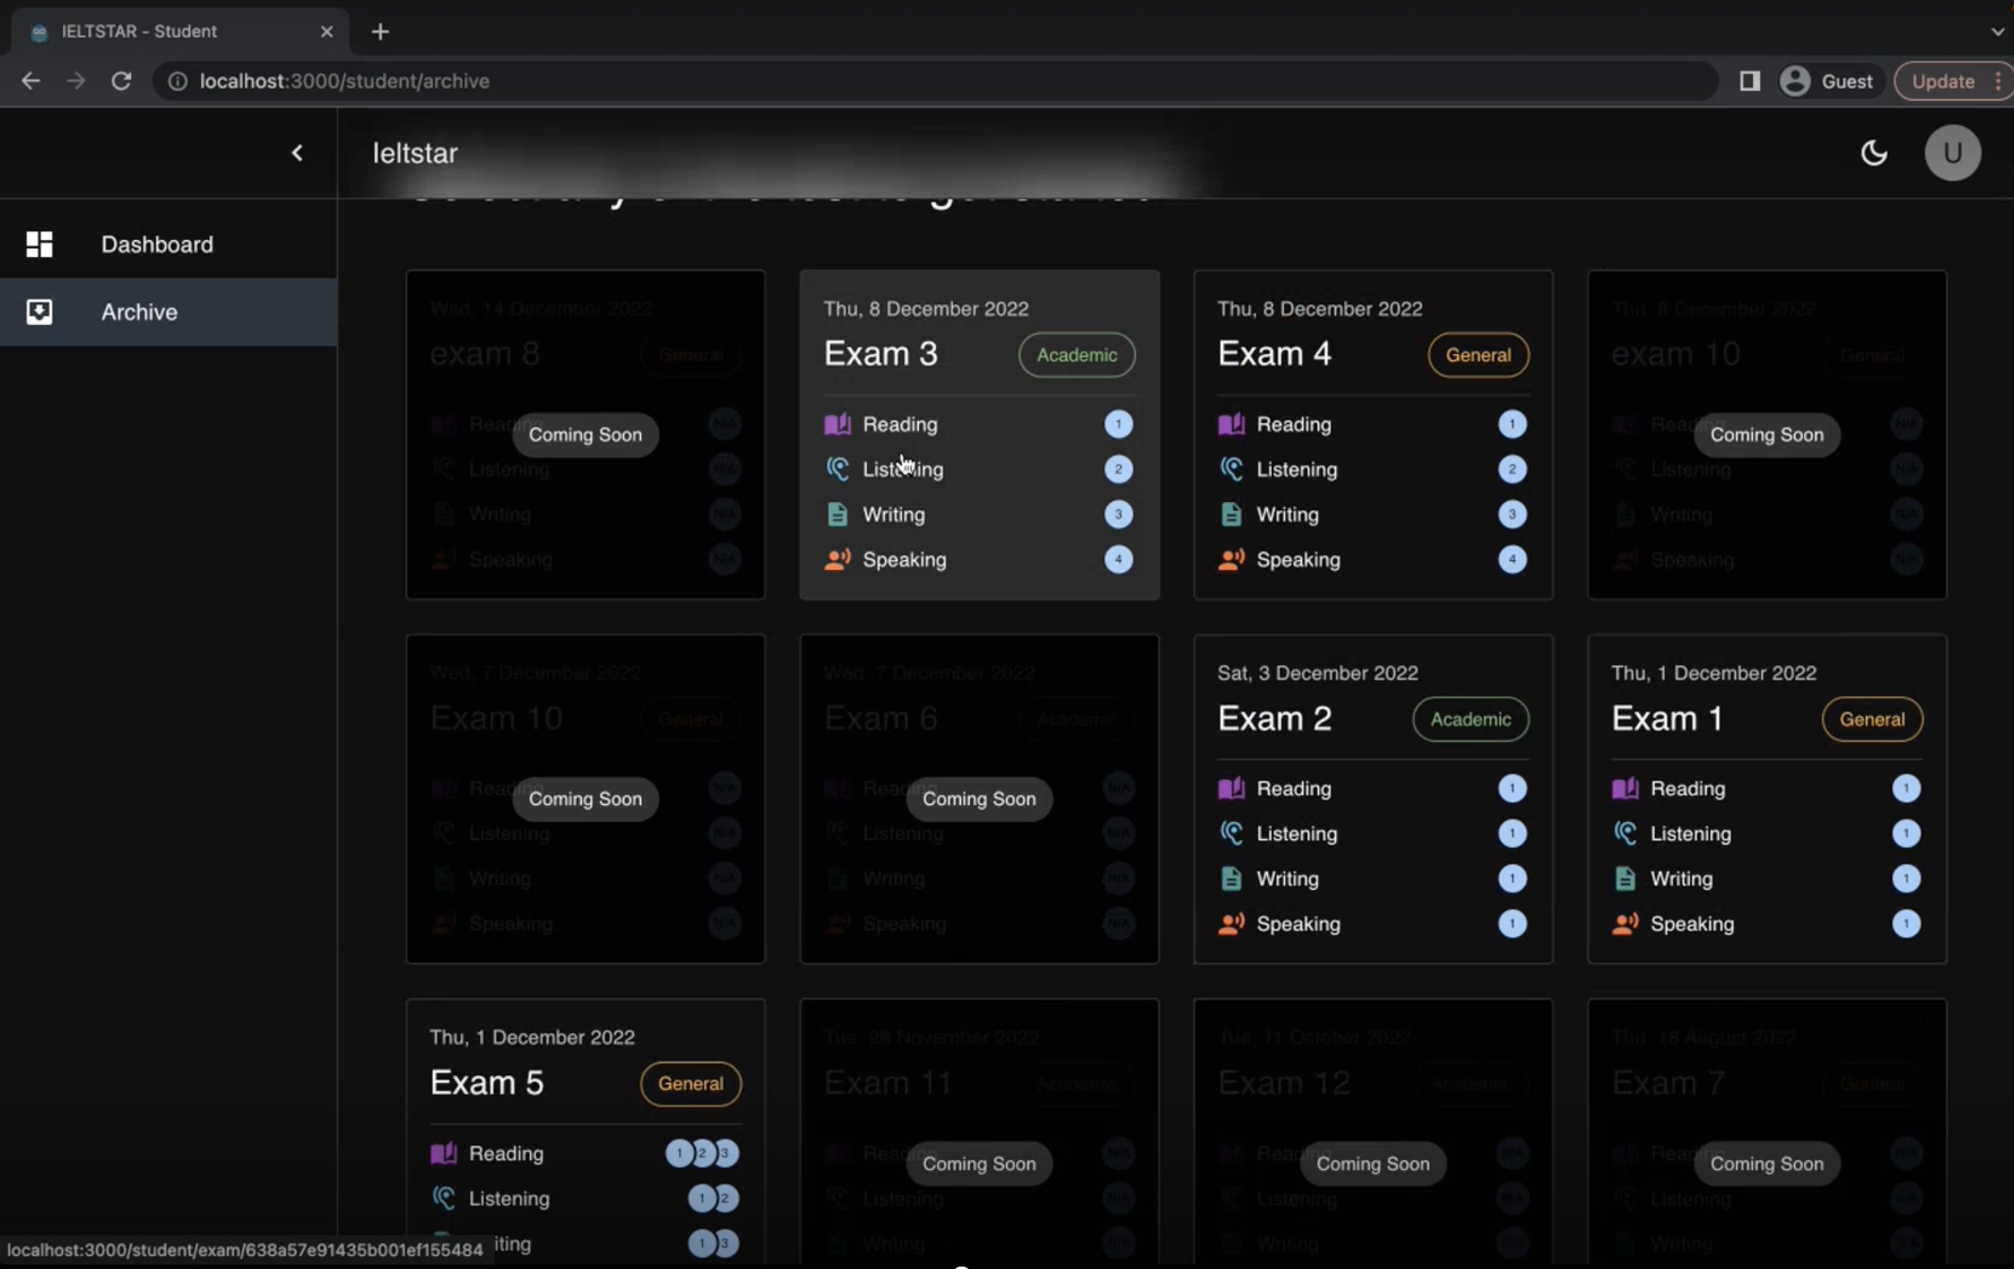
ARCHIVE

Slide 9
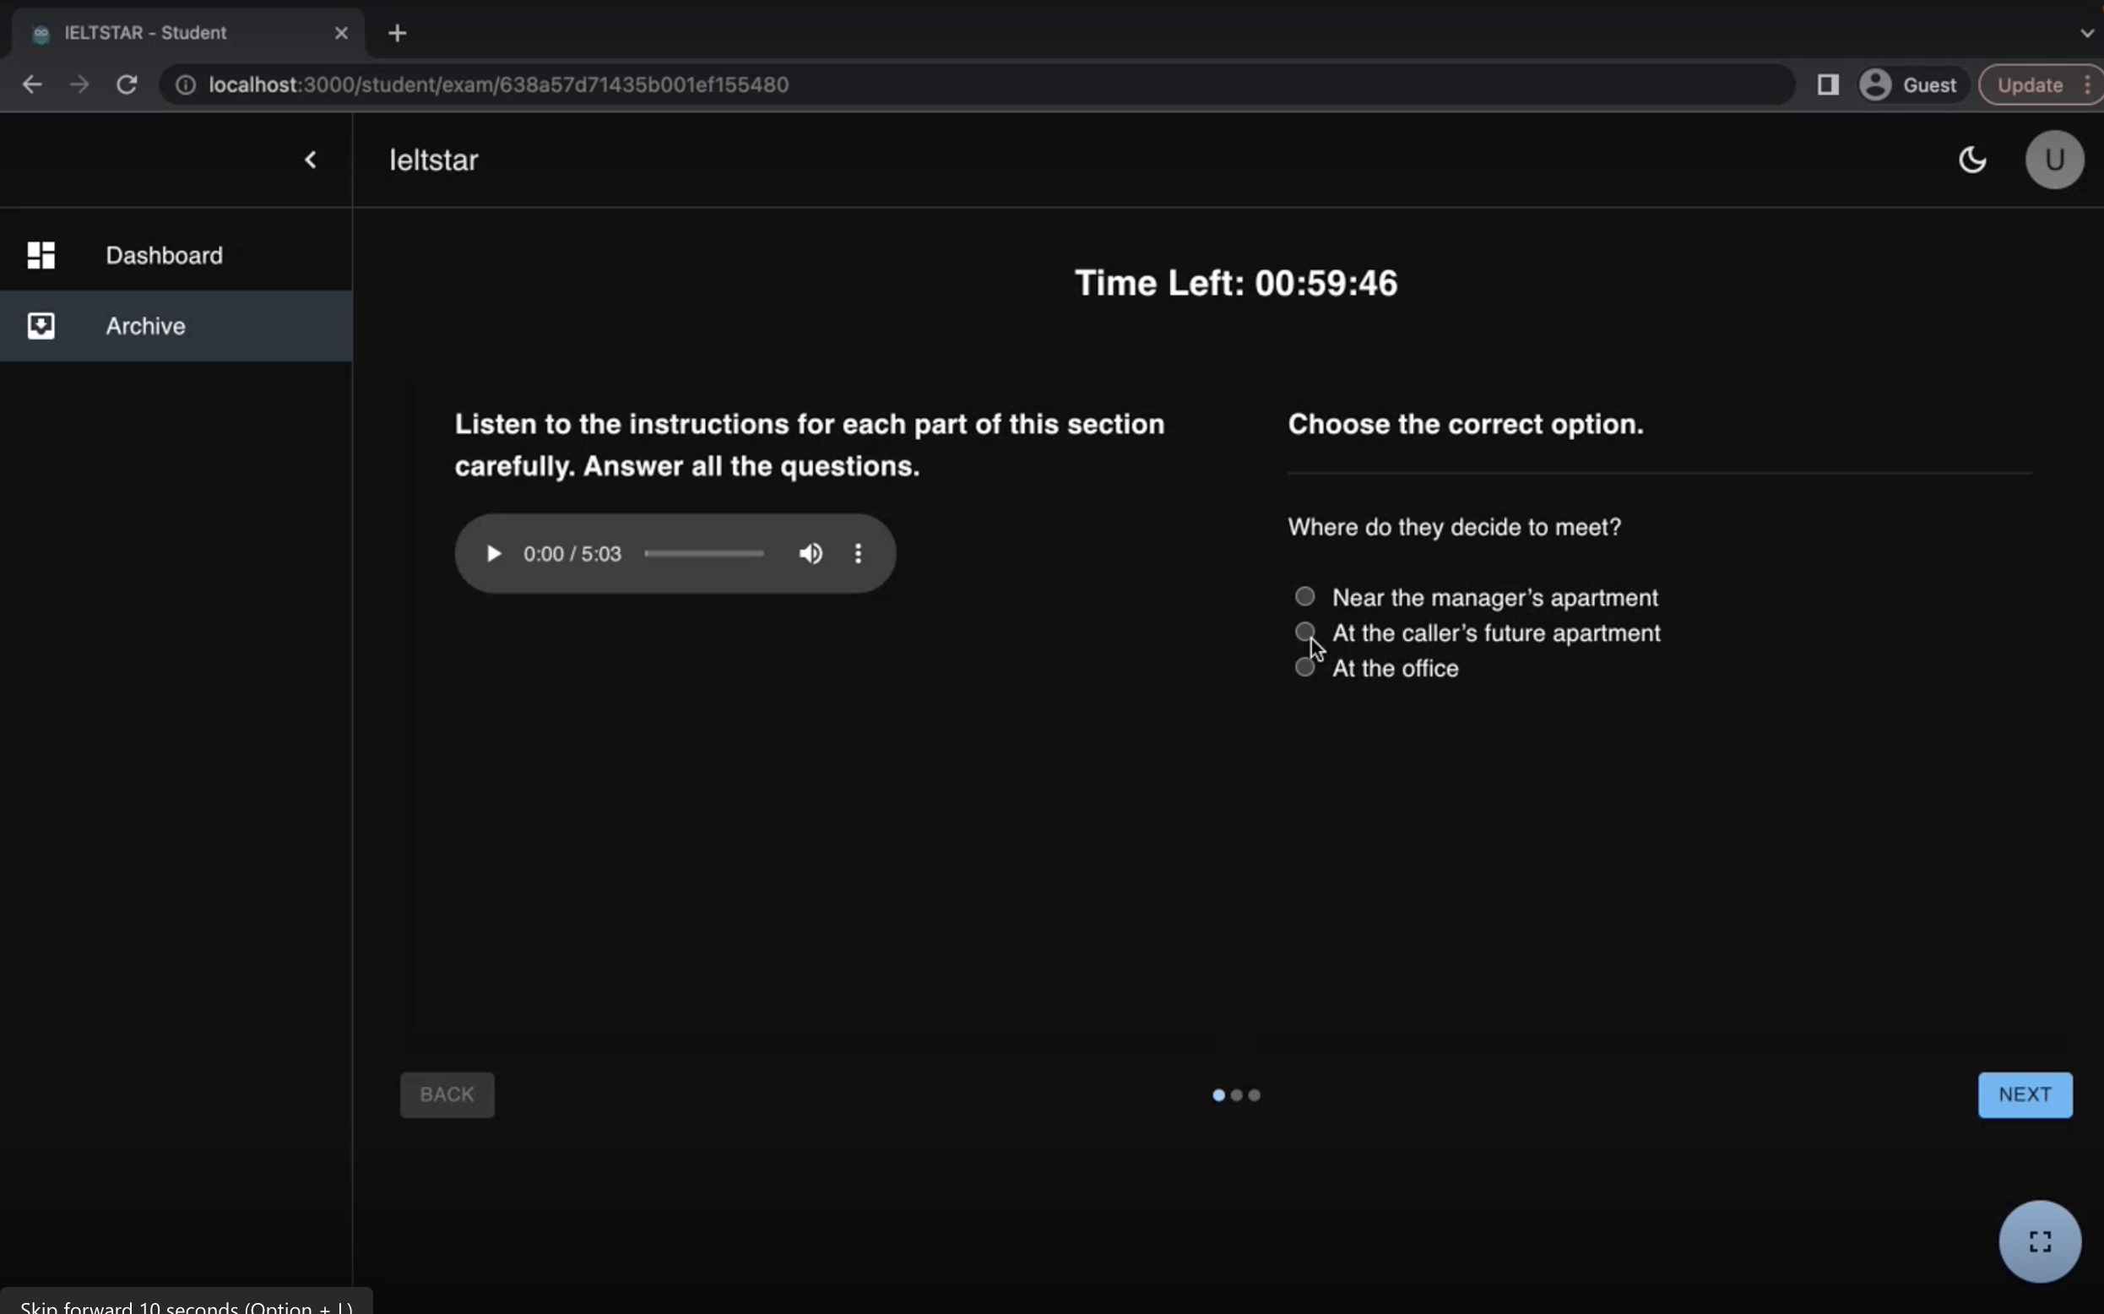
TEST

Slide 10
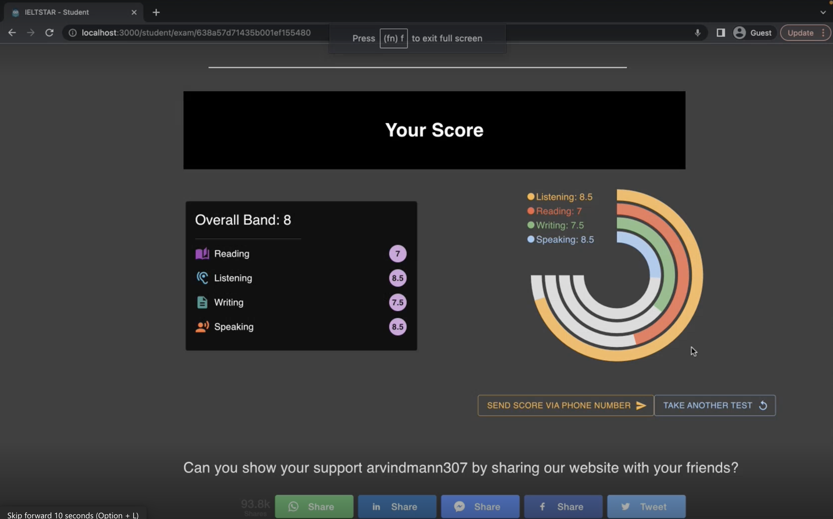
SCOREBOARD

Slide 11
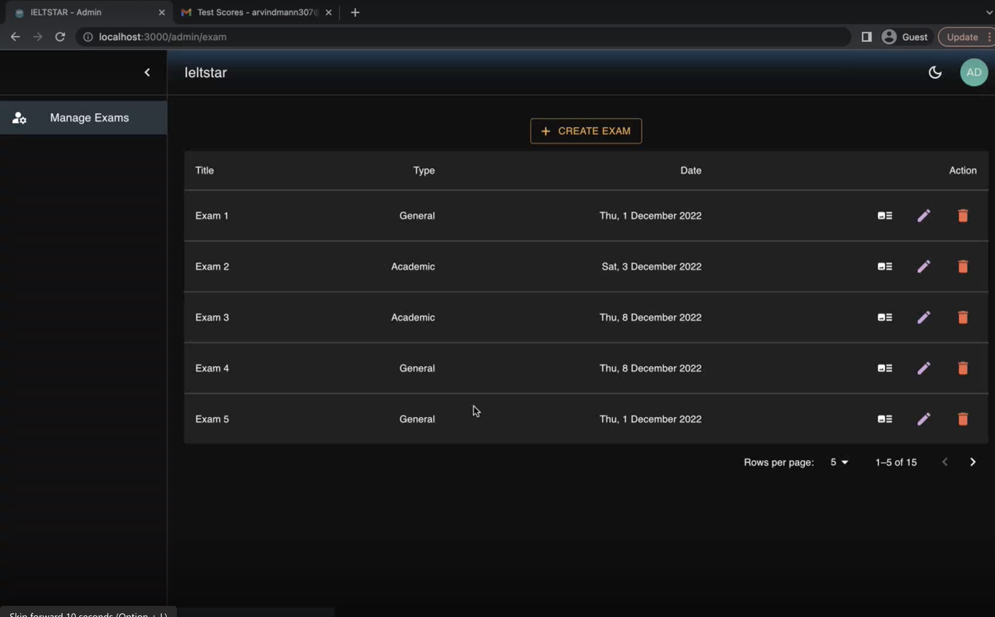
ADMIN DASHBOARD

Slide 12
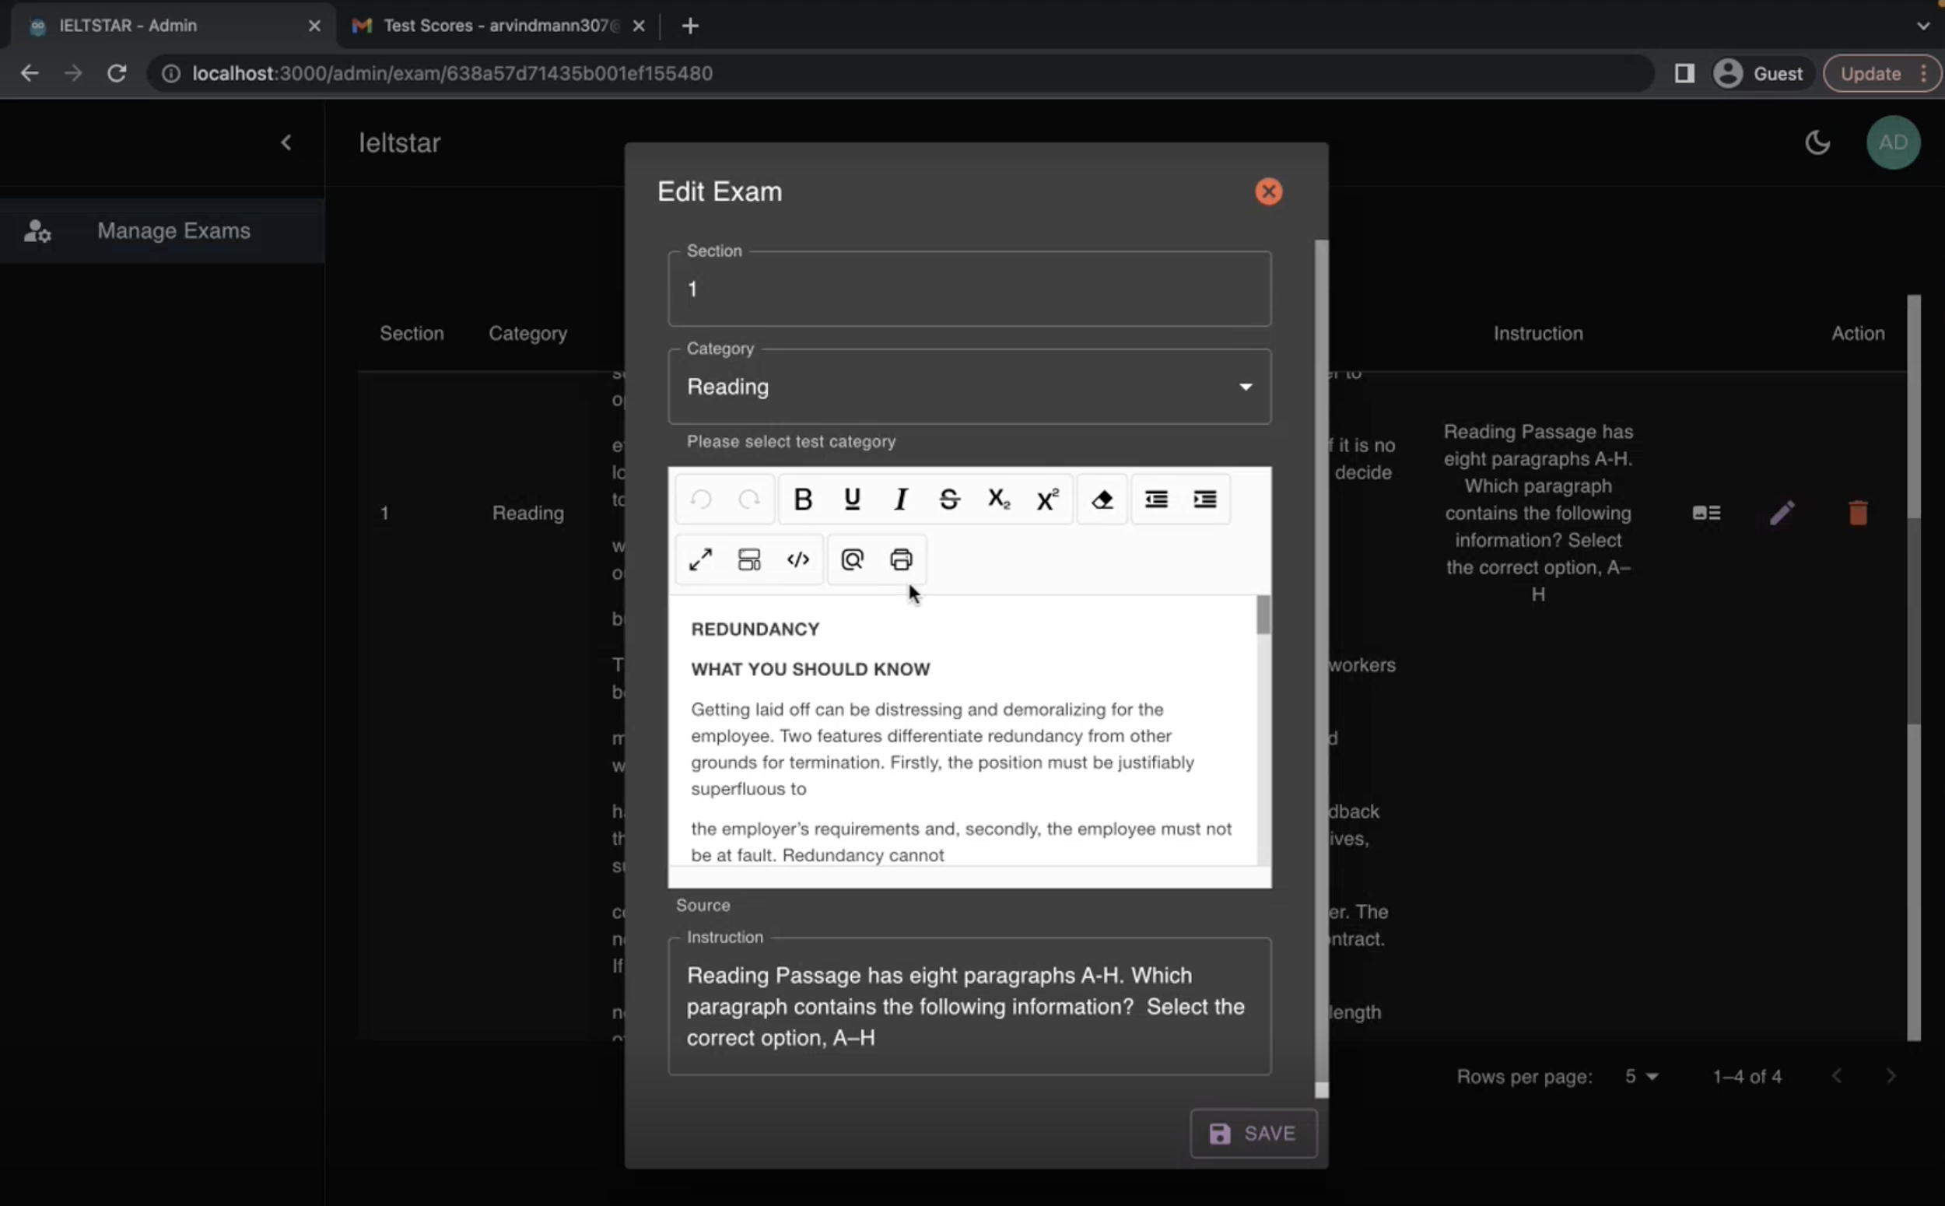
EDIT EXAM

Slide 13
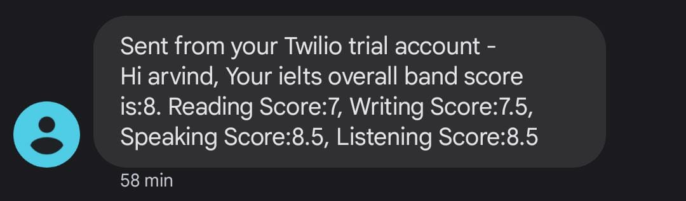
Score via SMS

Slide 14
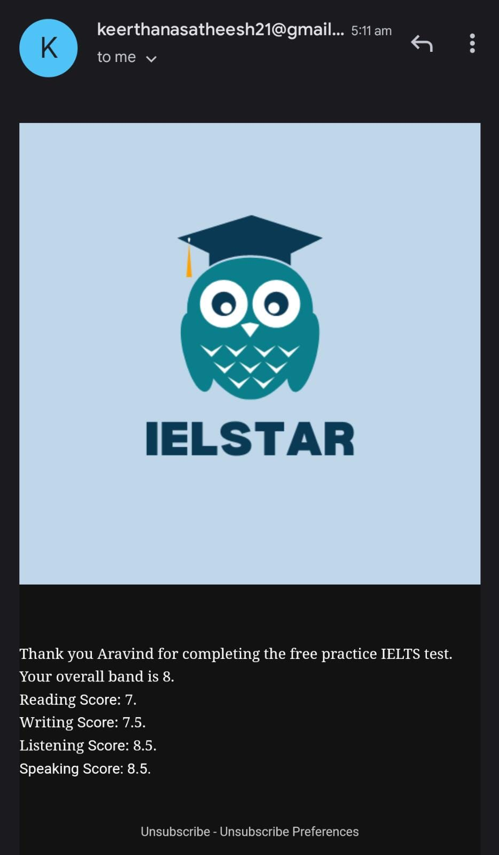
Score via Email

Slide 15
REFERENCES
https://nextjs.org/docs/getting-started
https://auth0.com/docs
https://www.twilio.com/docs
https://developer.grammarly.com/docs/
https://blog.loginradius.com/engineering/quick-look-at-react-speech-recognition/

Slide 16




Thank You for your time!
Amey Bansod
Harshil Shah
Keerthana Satheesh
Saloni Talwar
Notes:
https://northeastern.instructure.com/courses/123854/assignments/1471922

